Slide 1

Hepatitis in the United States
Soltanagha Huseynov
Matriculation number: 803218
soltanagha.huseynov@stud.th-deg.de

Slide 2
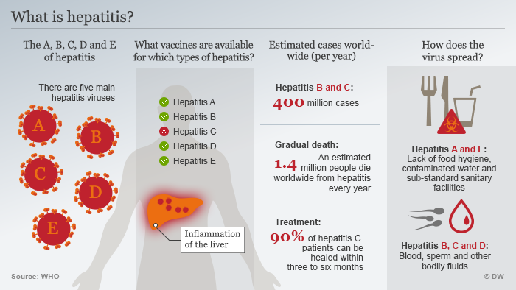

Slide 3
Outline
What is Project Tycho ?
When hepatitis infection found in US?
Highest infection level and how it distributed in timeline of US history?
Which counties in the United States had the highest annual infection rate by Hepatitis A and Hepatitis B?

Slide 4
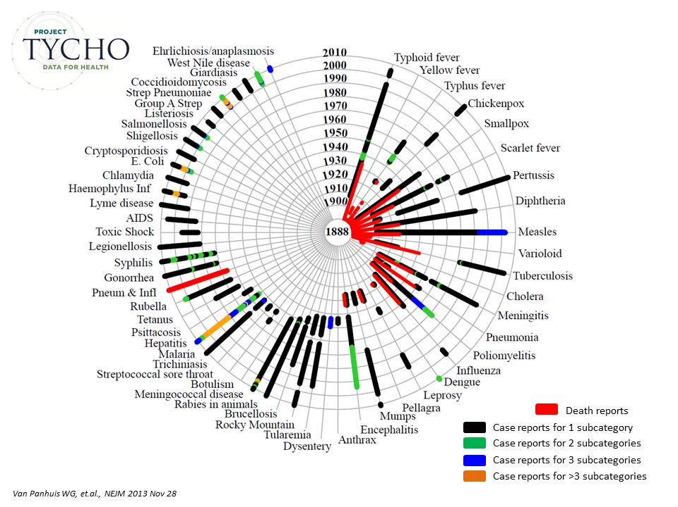
What is Project Tycho?
Standardize data about diseases and their determinants
Create machine-interpretable metadata
Make data widely available to users

Slide 5
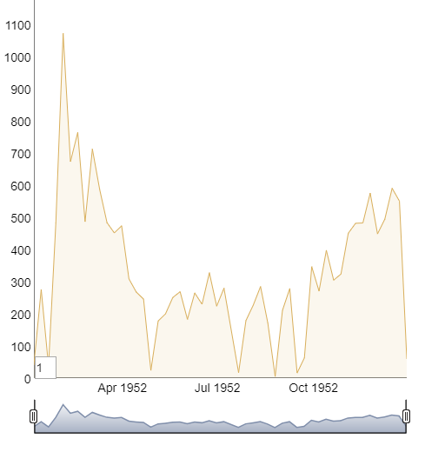
When hepatitis infection found in US?
Infection hepatitis was added in 1951 to the list of diseases to be reported weekly, but notification was known to be incomplete for that year and that's why our start point gonna be 1952.

Slide 6
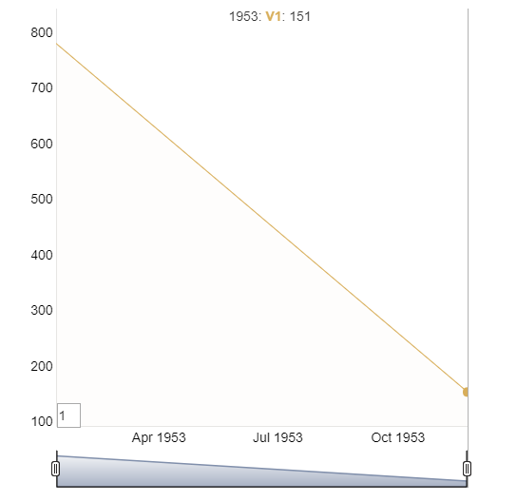
Hepatitis 1953 in US
The chart shows bimodal distribution which probably reflects data collection procedures rather than an actual seasonal trend.

Slide 7
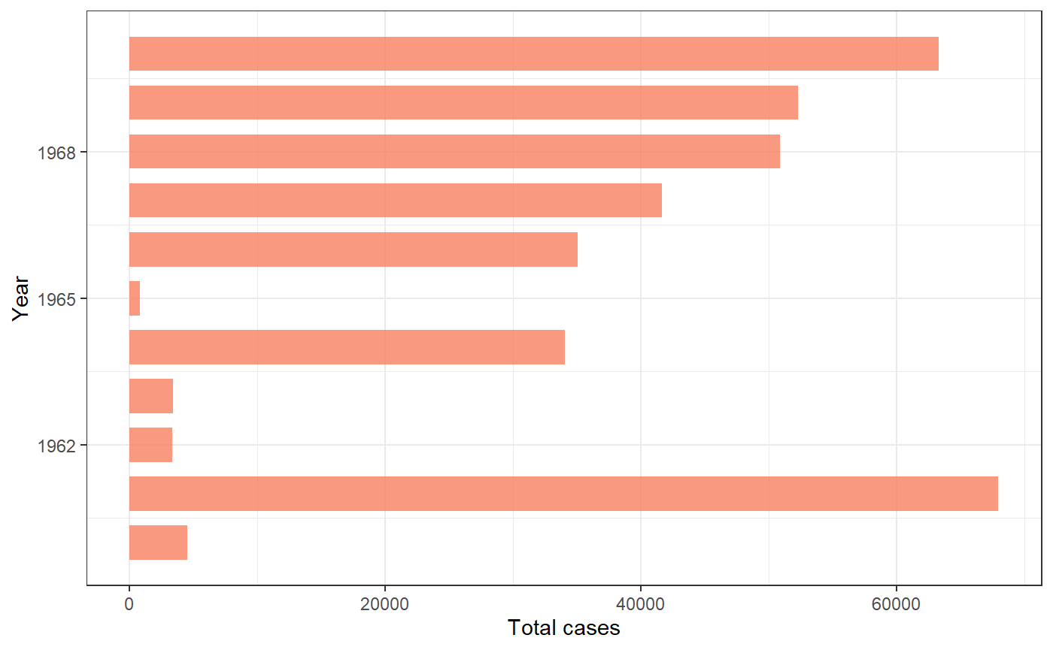
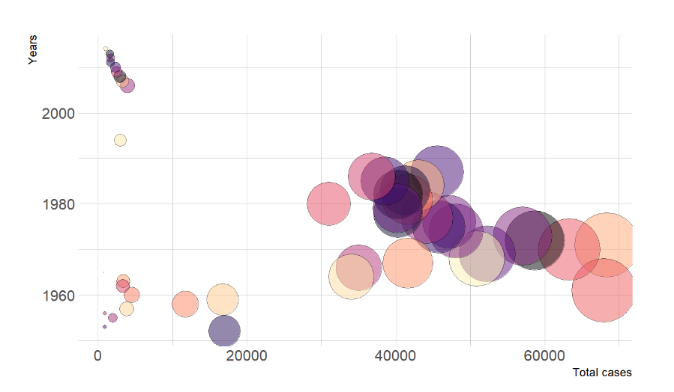
When in US highest annual infection rate by Hepatitis?
The large number of cases reported during these 4 years between 1966 and 1970 , but we have highest infection with 67,930 for 1961. After identifying highest year we can explore state based cases in US.

Slide 8
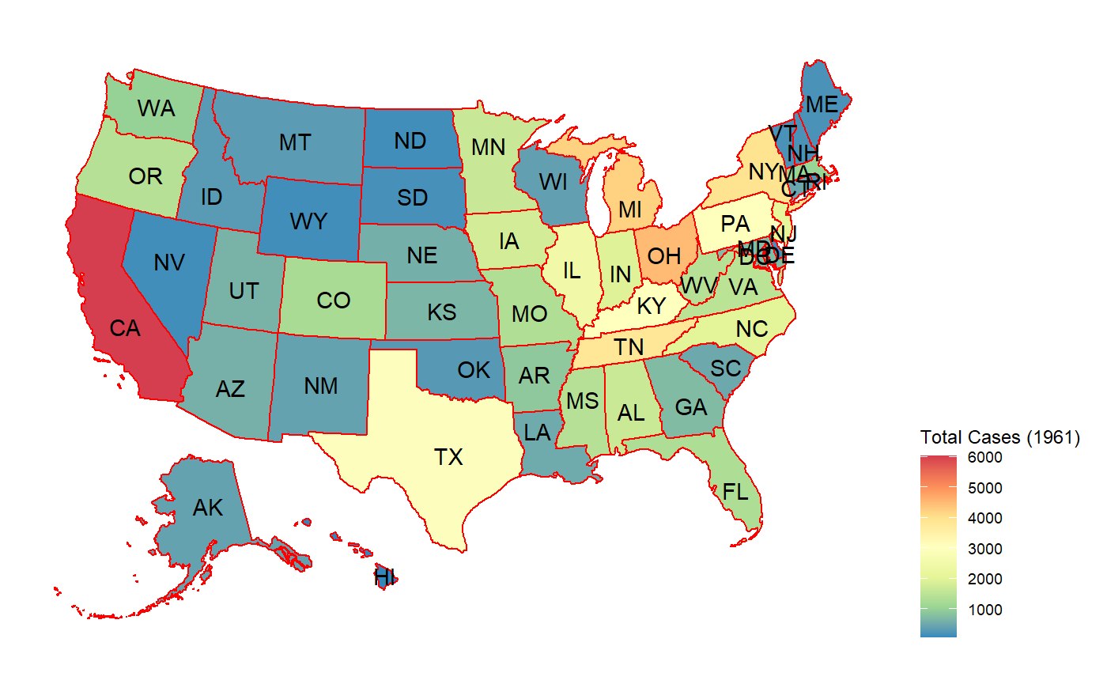
Highest infection cases by Hepatitis in US
Distribution on map indicates CA (CALIFORNIA) highest accordingly the OH (OHIO) , MI(MICHIGAN) and NY (NEW YORK) states has more than 4,000 infection cases in 1961.

Slide 9
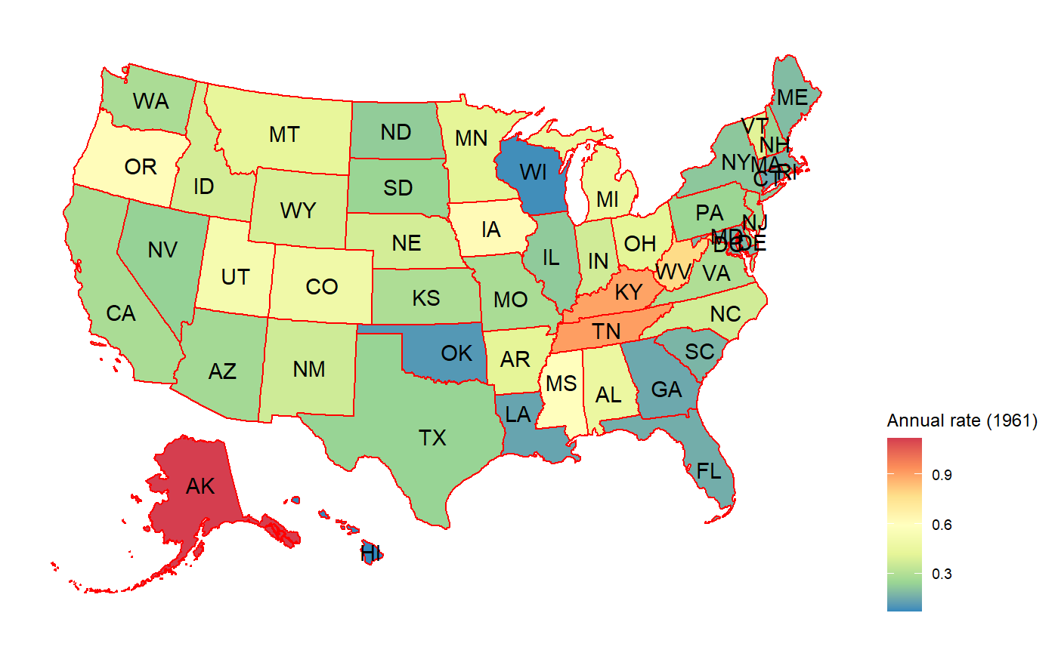
Highest annual infection rate in US

Slide 10
Conclusion
Project Tycho data global health informatics aims to improve access, representation, and interoperability of data produced by health agencies and researchers working in global health.
Highest infection rate was detected in 1961.
It can be observed that southern states had a noticeably higher number of cases than the northern states. California and Florida had the largest number of incidents, when South Dakota had the smallest number of cases.

Slide 11
References
https://r-graph-gallery.com/
https://www.tycho.pitt.edu/global-health-research/
https://www.ncbi.nlm.nih.gov/pmc/articles/PMC5100695/
https://stacks.cdc.gov/view/cdc72320
https://eriqande.github.io/rep-res-web/lectures/making-maps-with-R.html

